Slide 1
2023 Spring Semester
AI – Based Journalism
Islam-Bek KURAKBAY
Haeun LEE
Jeyeong PARK

Slide 2
Table of contents
1
Can AI replace the human reporters?
2
AI as assistant
3
Ask Chat GPT!
4
Deepfake in Journalism
ⓒSaebyeol Yu. Saebyeol’s PowerPoint

Slide 4
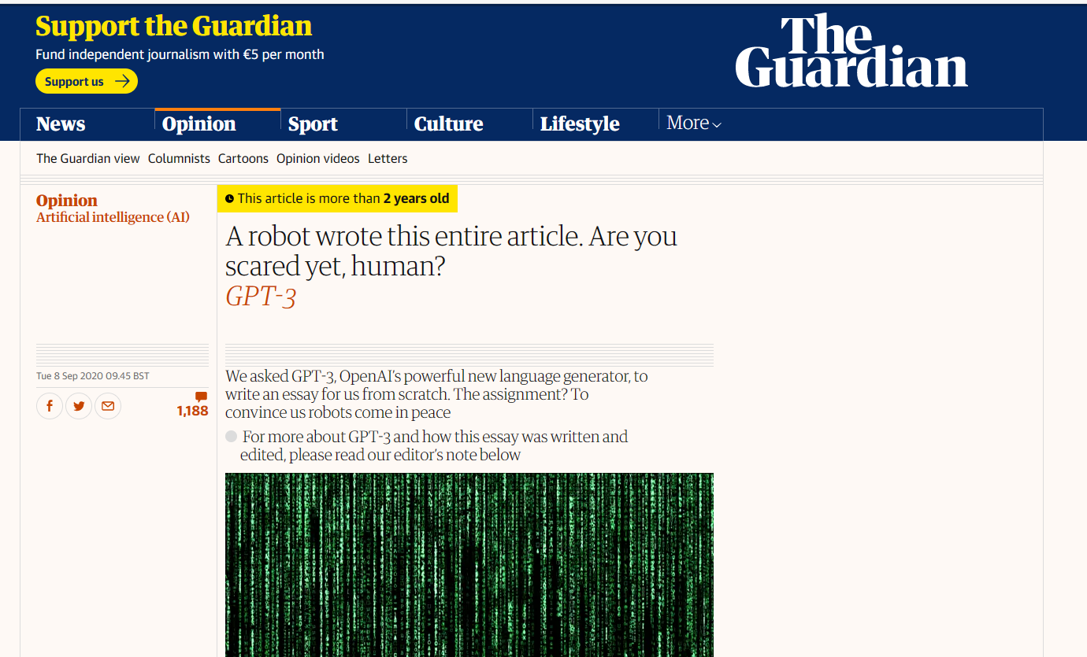
Part 1
Can AI replace the human reporters?
“Media tend to overrated AI bot”

Slide 5
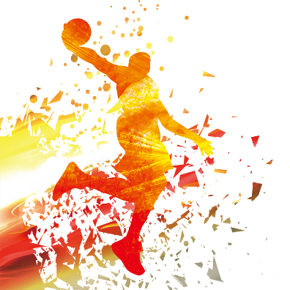
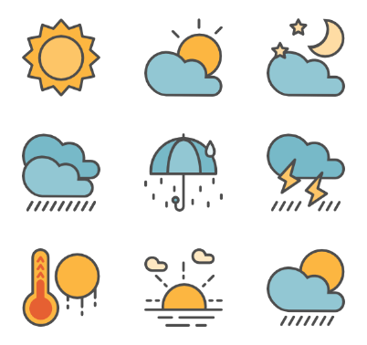
Part 1
Can AI replace the human reporters?

Slide 6
Part 1
Can AI replace the human reporters?

Slide 7
Part 1
Can AI replace the human reporters?

Slide 8
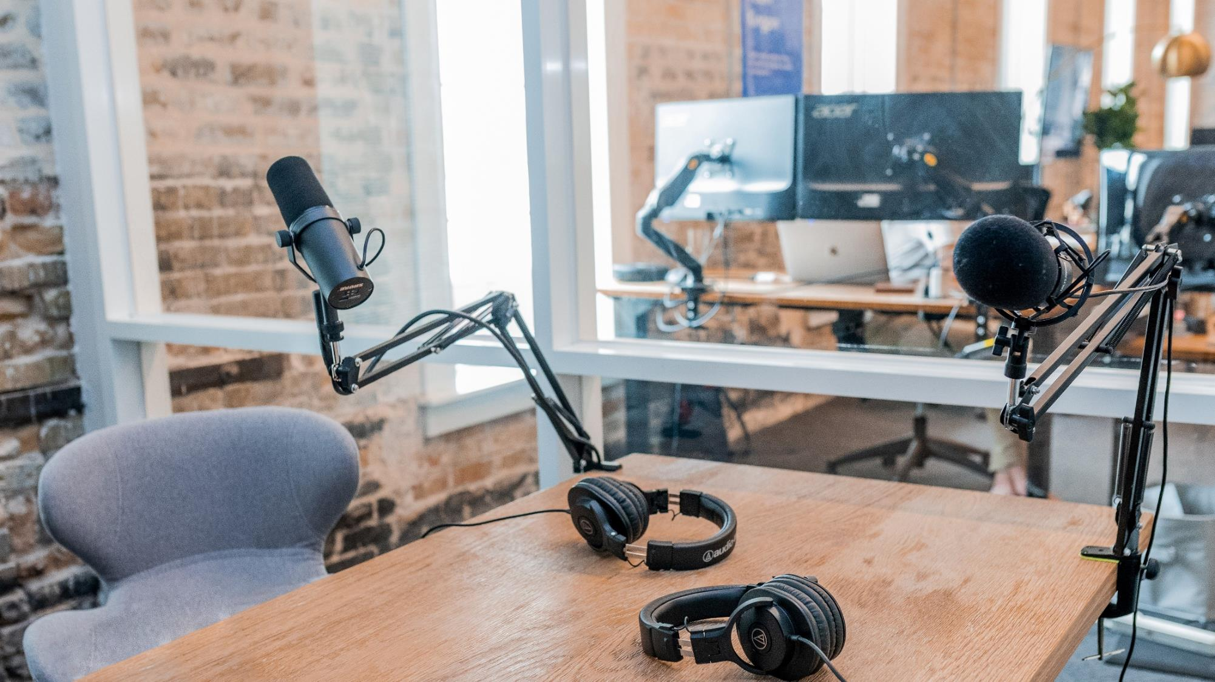
Part 2
AI as assistant
Searching
Solution
Summary
Revision
ⓒSaebyeol Yu. Saebyeol’s PowerPoint

Slide 9
Part 2
AI as assistant

Slide 10
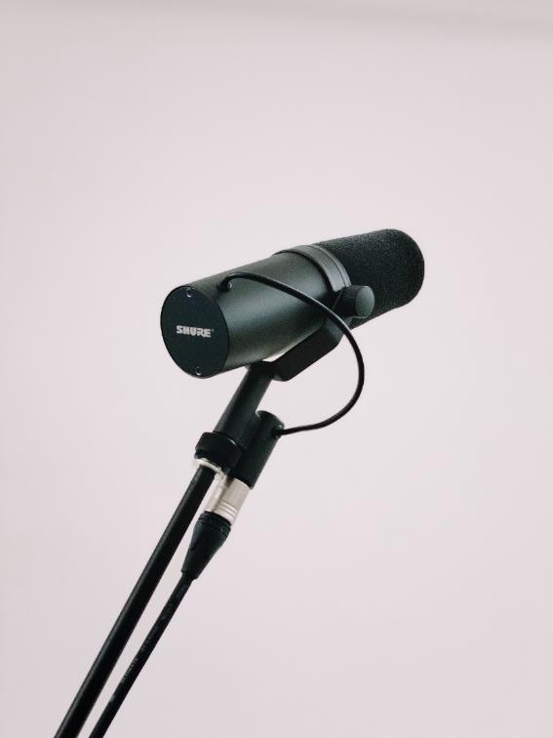
“ ”
AI changes the type of work journalists do

Slide 11
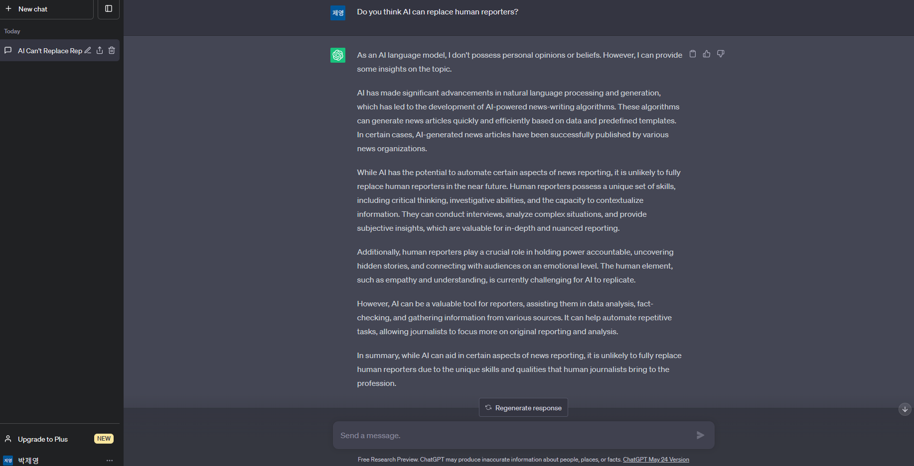
Part 3
Ask Chat GPT!

Slide 12
Part 3
Ask Chat GPT!

Slide 13
Part 1
제목을 입력하세요

Slide 14
Part 4
Deepfake

Slide 15
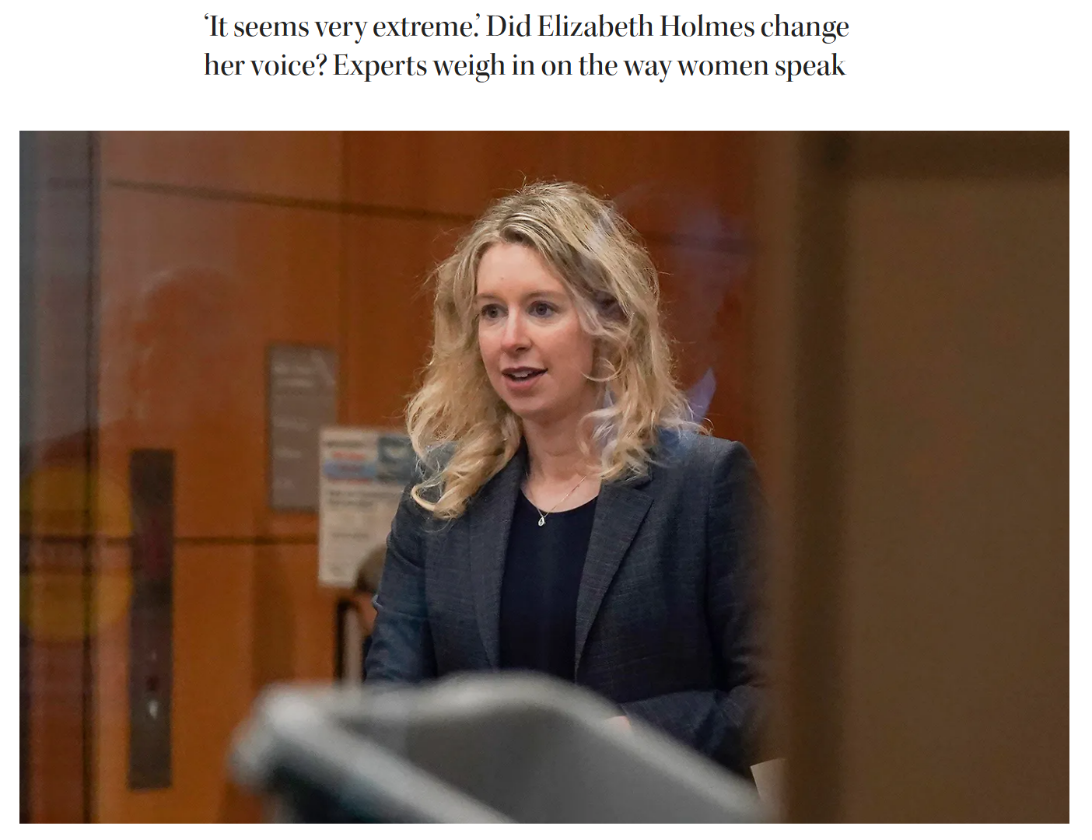
Part 4
Fake Voices with AI
news.northeastern.com

Slide 16
Thank you!

